Slide 1
Machine Learning CS601PC Chapter 12. Combining Inductive and Analytical Learning

Slide 2
Inductive and Analytical Learning
Inductive learning
Hypothesis fits data
Statistical inference
Requires little prior knowledge
Syntactic inductive bias
Analytical learning
Hypothesis fits domain the
Deductive inference
Learns from scarce data
Bias is domain theory

Slide 3
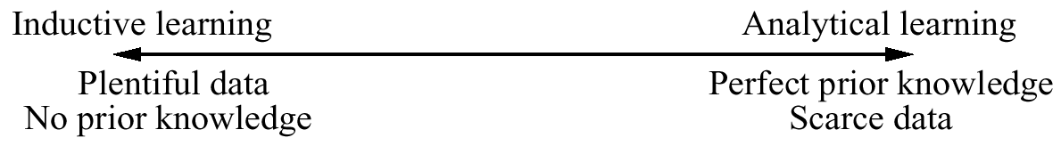
What We Would Like
General purpose learning method:
No domain theory → learn as well as inductive methods
Perfect domain theory → learn as well as Prolog-EBG
Accomodate arbitrary and unknown errors in domain theory
Accomodate arbitrary and unknown errors in training data

Slide 4
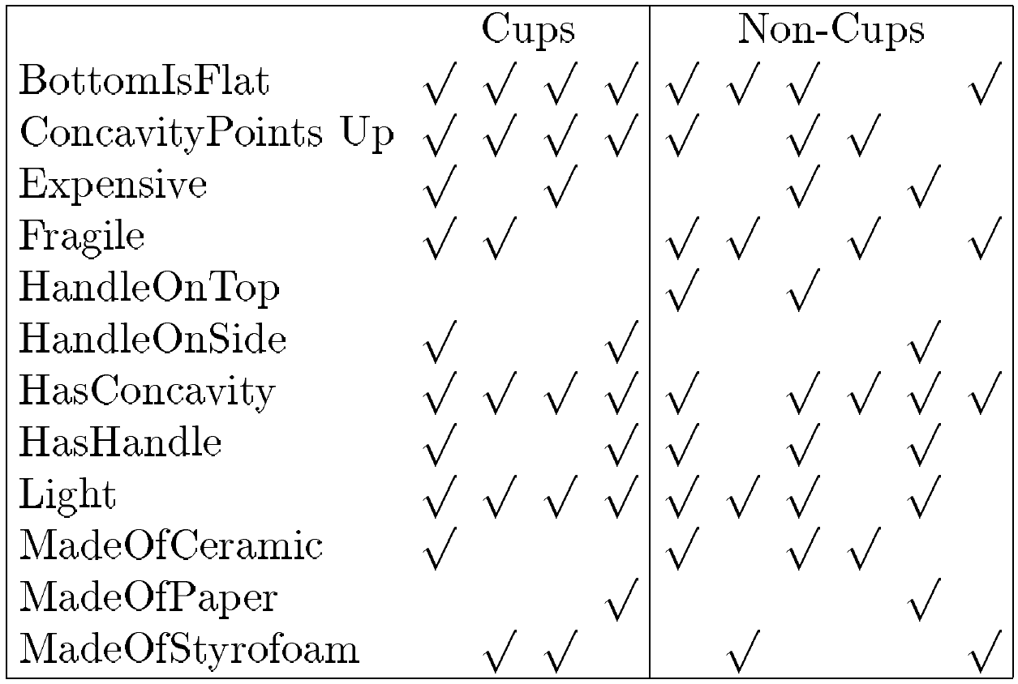
Domain theory:
Cup ← Stable, Liftable, Open Vessel
Stable ← BottomIsFlat
Liftable ← Graspable, Light
Graspable ← HasHandle
Open Vessel ← HasConcavity, ConcavityPointsUp
Training examples:

Slide 5
KBANN
KBANN (data D, domain theory B)
1. Create a feedforward network h equivalent to B
2. Use BACKPROP to tune h to t D

Slide 6
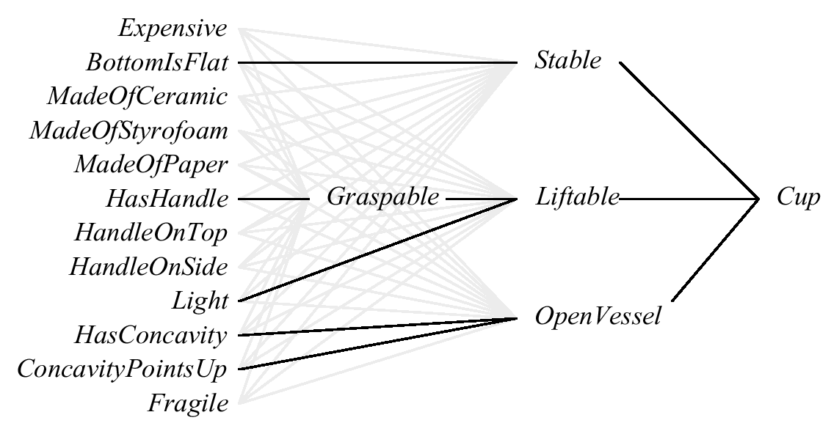
Neural Net Equivalent to Domain Theory

Slide 7
Creating Network Equivalent to Domain Theory
Create one unit per horn clause rule (i.e., an AND unit)
Connect unit inputs to corresponding clause antecedents
For each non-negated antecedent, corresponding input weight w ← W, where W is some constant
For each negated antecedent, input weight w ← -W
Threshold weight w₀ ← -(n-.5)W, where n is number of non-negated antecedents
Finally, add many additional connections with near-zero weights
Liftable ← Graspable, ¬Heavy

Slide 8
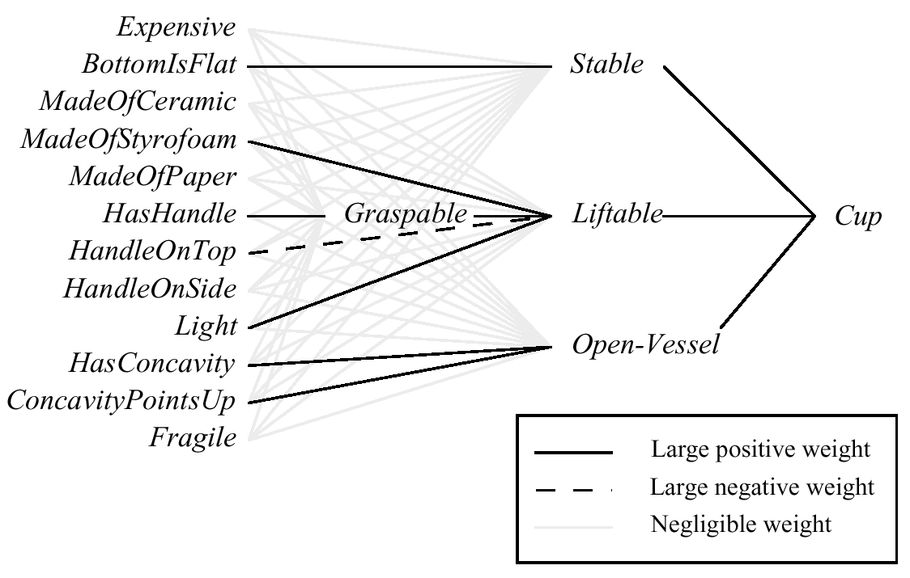
Result of refining the network

Slide 9
KBANN RESULTS
Classifying promoter regions in DNA leave one out testing:
Backpropagation : error rate 8/106
KBANN: 4/106
Similar improvements on other classification, control tasks.

Slide 10
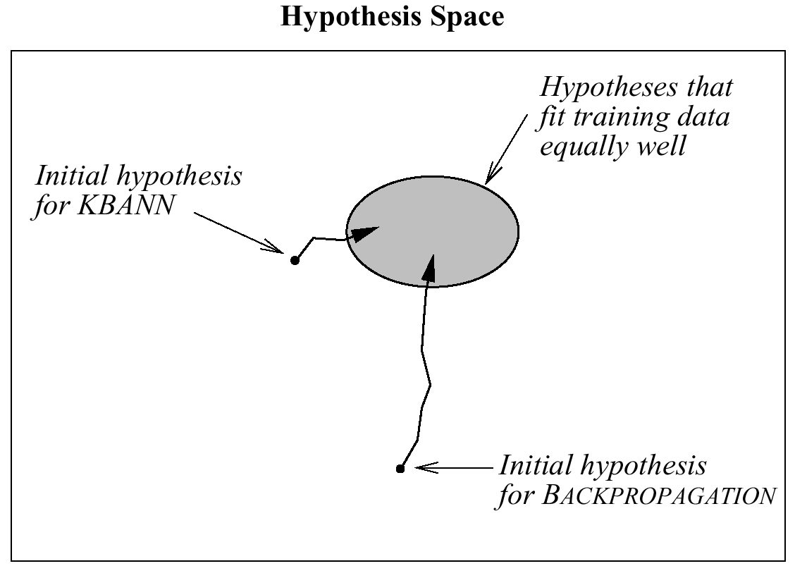
Hypothesis space search in KBANN

Slide 11
EBNN
Key idea:
Previously learned approximate domain theory
Domain theory represented by collection of neural networks
Learn target function as another neural network

Slide 12
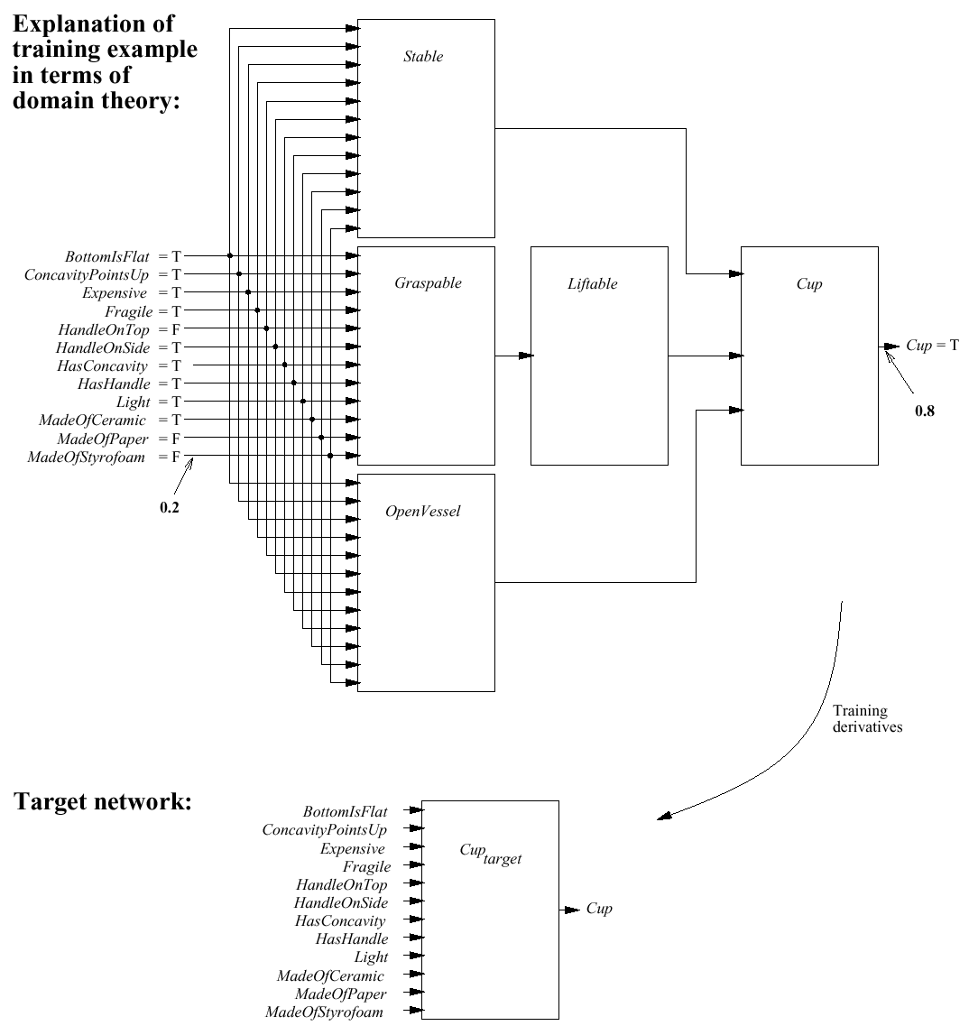

Slide 13
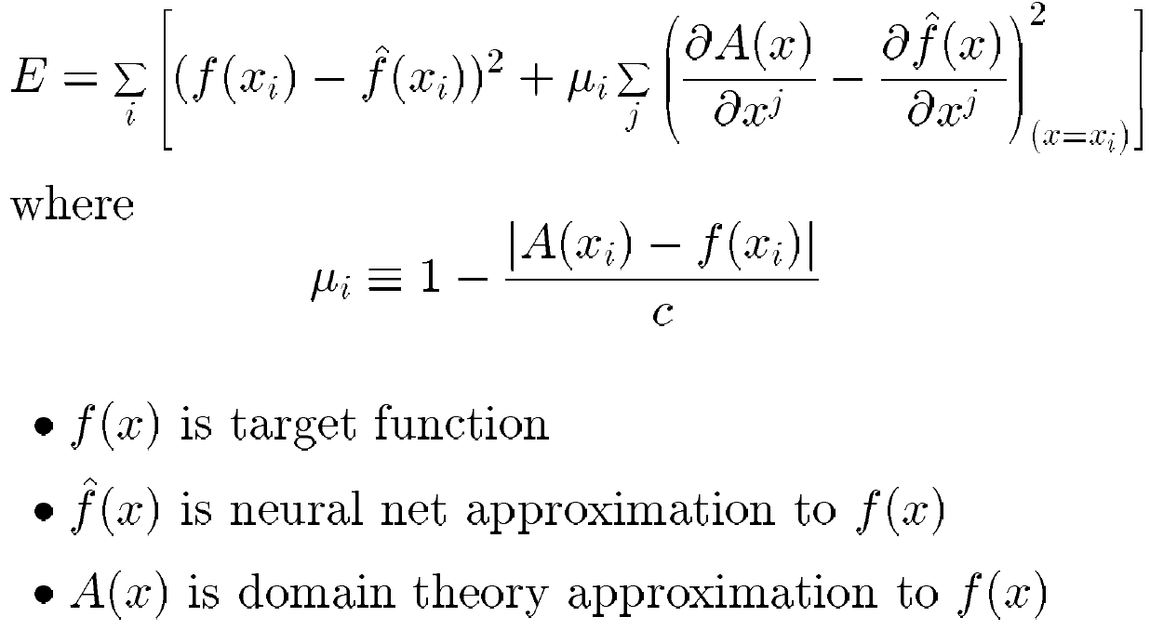
Modified Objective for Gradient Descent

Slide 14
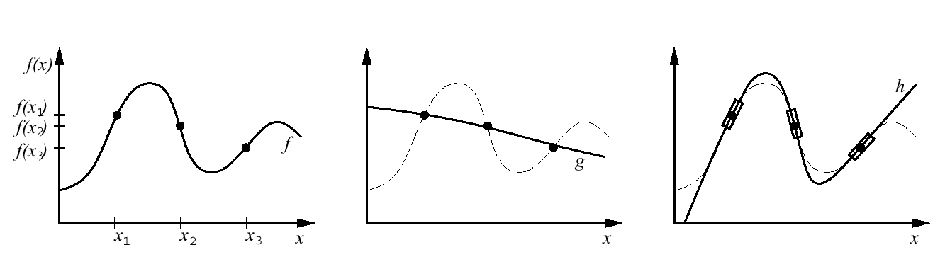

Slide 15
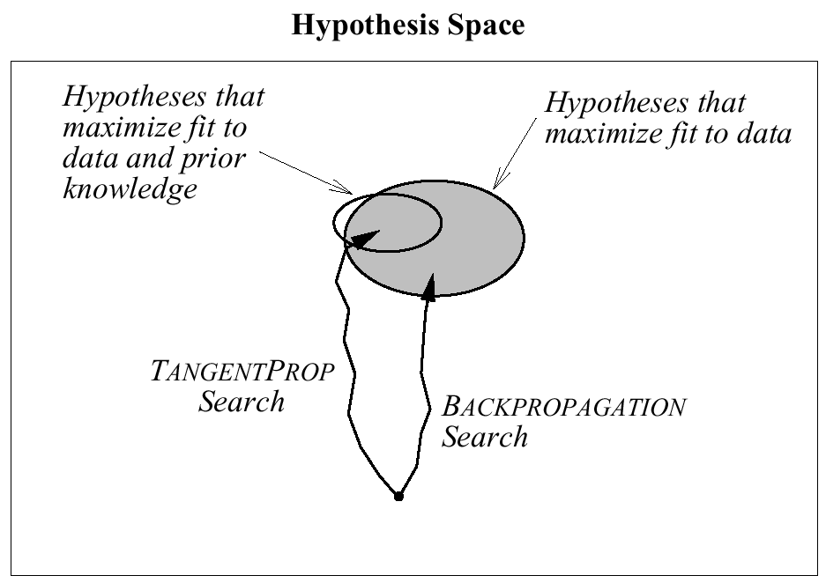
Hypothesis Space Search in EBNN

Slide 16
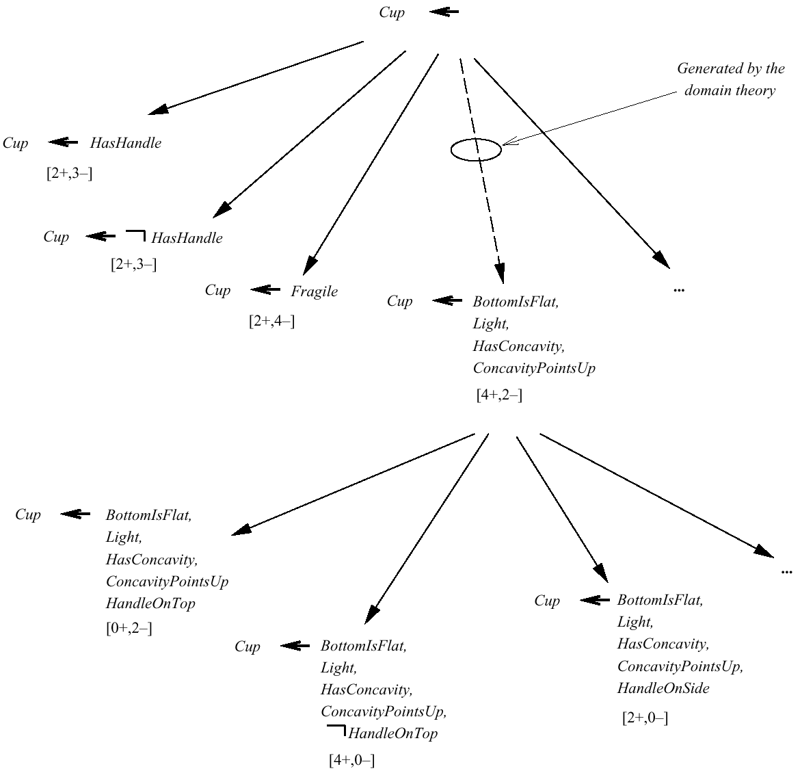
Search in FOCL

Slide 17
FOCL RESULTS
Recognizing legal chess endgame positions:
30 positive, 30 negative examples
FOIL : 86%
FOCL : 94% (using domain theory with 76% accuracy)
NYNEX telephone network diagnosis
500 training examples
FOIL : 90%
FOCL : 98% (using domain theory with 95% accuracy)

